Slide 1
Finsite Bank — Finance Analytics Dashboard
Power BI | DAX | Time Intelligence | Data Modeling | Dashboard Design
Project Report — Personal / Portfolio Project
Platform
Scope
Microsoft Power BI Desktop
End-to-end analytics build
Period
Type
2023 – 2026 transactions
Portfolio / Personal Project

Slide 2
1. Project Overview
This is an end-to-end Power BI finance analytics project built for a fictional bank, "Finsite Bank," covering the full workflow: data collection, cleaning, modeling, DAX measure design, and dashboard build-out. The project simulates a real banking transactions dataset spanning 2023–2026, scaled down from real-world volumes (transactions reduced at roughly a 1:100 ratio) while keeping the structure and patterns of genuine transaction data.
It is built as two connected report pages — an Overview Analysis dashboard and a Transactions dashboard — using two related tables (a transactions table and a customers table) joined through data modeling.
Project Scope at a Glance
Data collection & cleaning
Relational data modeling
DAX measure design
Dashboard build-out
Two connected report pages
Transactions + Customers tables

Slide 3

2. Problem Statement & Objectives
1
2
Unified Stakeholder View
Year-on-Year Comparisons
Give banking stakeholders a single, interactive view of transaction volume, value, fees, and tax collected across years, regions, and customer segments.
Show YoY growth or decline for every core metric, using the currently selected year vs. the same period last year — including partial-year comparisons.
3
4
Dynamic Metric Switching
Root-Cause Investigation
Let users dynamically switch the underlying metric driving the charts (Amount, Fees, Tax, or Transactions) instead of building separate charts for each.
Support drill-through from summary visuals into detail records (e.g., a specific month or failed-transaction status) and enable export of filtered records to CSV.

Slide 4
3. Tools & Data Source
Tool
Customers Table Fields
Microsoft Power BI Desktop — data modeling, DAX, and report design. Planned publishing to Power BI Service and Microsoft Fabric.
Customer Segment (retail, premium, corporate, wealth)
Occupation (student, freelancer, etc.)
Transactions Table Fields
Gender
Transaction ID, Amount, Fee Amount, Tax Amount
Transaction Date, Status, Type, Category
Calendar / Date Table
A dedicated Calendar table related to the transactions table on the date field, used exclusively for all time-intelligence calculations to ensure reliability even when transaction dates have gaps.
State (geographic dimension)
Data Period
2023 – 2026 | Scale: ~1:100 ratio vs. real-world volumes

Slide 5
4. Data Modeling Approach
1
Relational Table Structure
2
Standalone Calendar Table
3
Global Year Filter with Partial-Year Awareness
Two fact/dimension-style tables — transactions and customers — connected through data modeling rather than kept as flat, disconnected data. This enables cross-table filtering and segmentation analysis.
A dedicated Calendar table related to the transactions table on the date field, so time-intelligence functions behave reliably instead of relying on transaction dates directly, which can have gaps and cause incorrect period calculations.
A global year filter (2023–2026) applied across the report. Selecting a year automatically recalculates every YoY comparison against the prior year. For example, 2026 has only Jan–Apr of data, so the YoY comparison correctly compares against the same four months of 2025 — not a full year — ensuring accurate like-for-like analysis.

Slide 6
5. Key DAX Measures Built
For each of the 5 core KPIs, the same repeatable three-step DAX pattern was used: (1) a base measure, (2) a previous-year version using SAMEPERIODLASTYEAR() against the Calendar table, and (3) a YoY growth and YoY % measure comparing the two.
Measure
DAX Logic (plain terms)
Business Purpose
Total Amount
SUM of transaction Amount
Overall transaction value for the period
Previous Year Amount
SAMEPERIODLASTYEAR() on the Calendar table
Baseline for year-on-year comparison
YoY Amount / YoY %
Current − Previous, then ÷ Previous
Growth or decline vs. last year
Total Transactions
DISTINCTCOUNT of Transaction ID
Number of transactions processed
Average Transaction Value
AVERAGE of Amount
Typical transaction size
Total Fees / Total Tax
SUM of Fee Amount / Tax Amount
Revenue and tax components tracked separately
Previous Year & YoY versions
Same SAMEPERIODLASTYEAR() pattern repeated
Consistent YoY view across every KPI

Slide 7
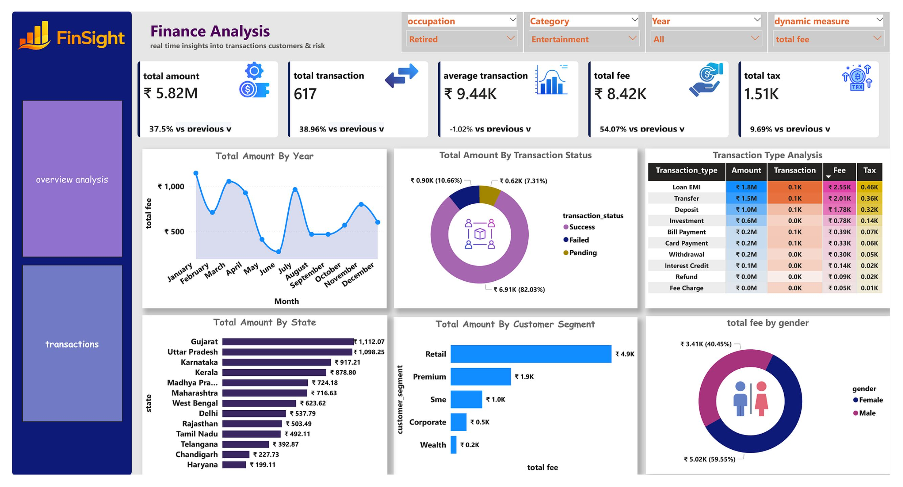
6. Dashboard Pages & Features
Figure 1: Overview Analysis dashboard — KPI cards, YoY trends, and regional/segment breakdowns

Slide 8
6.1 Overview Analysis Dashboard
Headline KPI Cards
Drill-Down Chart Suite
5 headline KPI cards — Total Amount, Total Transactions, Average Transaction Value, Total Fees, Total Tax — each with a secondary YoY badge showing growth/decline vs. the previous year.
Chart
Visual Type
Purpose
Amount by Month
Line / area
Seasonal spikes or drops
Amount by Transaction Status
Donut chart
Successful vs. failed vs. pending
Dynamic Measure Selector
A runtime metric switcher lets any chart be re-driven by a different metric (Amount, Fees, Tax, or Transactions) without building one chart per metric.
Amount by Customer Segment
Horizontal bar
Most valuable customer groups
Additional Slicers
Amount by State
Bar / map
Regional performance
Occupation (e.g., student, freelancer) and transaction category (e.g., fuel, food delivery, entertainment) slicers for granular filtering.
Amount by Transaction Type
Heatmap / table
Volume by type (EMI, transfer, etc.)
Amount by Gender
Bar / donut
Transaction behavior by gender

Slide 9
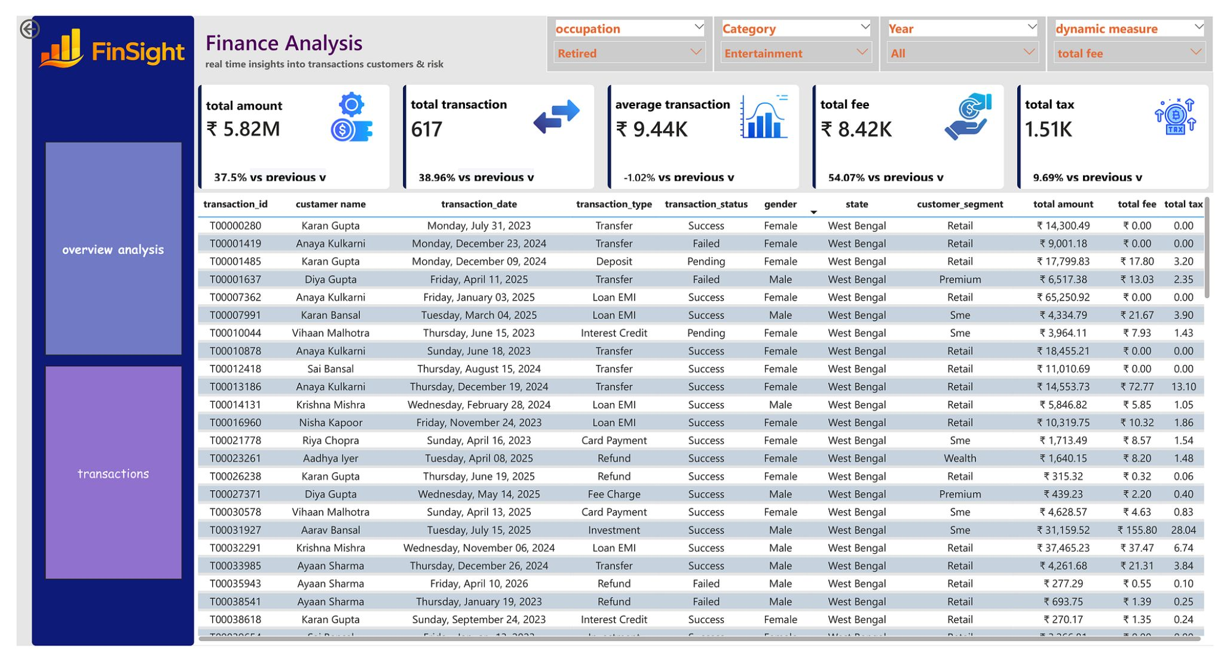
6.2 Transactions Dashboard
Figure 2: Transactions dashboard — detail-level transaction records with drill-through
Detail-Level View
Drill-Through Navigation
Export to CSV
Lists every individual transaction, built on the transactions and customers tables for full row-level visibility.
Drill from Overview Analysis into this page — e.g., a specific month's data point shows every underlying transaction for that month/year; drilling from "Failed" status filters the detail view accordingly.
Via the visual's "···" menu, a filtered view — such as all failed transactions or all transactions for a specific state — can be exported and handed off to another team.

Slide 10



7. Reference Label & Formatting Details (KPI Layer)
YoY Reference Labels
Indian Currency Formatting
Percentage & Icon Polish
Used the Reference Labels / Reference Label Layout feature to attach a small, styled YoY badge under each headline number, labeled "vs previous year," with black text on a white background for readability and visual contrast.
Applied Indian currency (₹) formatting on all monetary KPIs using the English (India) locale, ensuring numbers display in the correct lakh/crore notation familiar to banking stakeholders.
Formatted YoY measures as percentages, and added custom icons next to each KPI card for a cleaner, more intuitive layout that reduces cognitive load when scanning the dashboard.

Slide 11

8. Skills Demonstrated
DAX Functions
Interactivity
CALCULATE, SUM, AVERAGE, DISTINCTCOUNT, DIVIDE, and the SAMEPERIODLASTYEAR() time-intelligence function for consistent period comparisons.
Drill-through navigation, filtered CSV export, and multi-level slicers (year, occupation, category) for self-service root-cause analysis.
Report Formatting
Data Modeling
Reference labels, locale-based number formatting (₹, English India), and visual polish with custom icons for a professional, stakeholder-ready output.
Relating multiple tables (transactions, customers, calendar) rather than working off a single flat table — enabling cross-table filtering and reliable time intelligence.
Deployment
Dynamic / Parameterized Reporting
Publishing to Power BI Service and Microsoft Fabric for cloud-hosted, shareable reporting.
Building charts that can be re-driven by different metrics at runtime, eliminating the need to duplicate visuals for each KPI.

